Slide 1
Lecture 10
Nonpremixed Turbulent Combustion:
Modelling
14.-1

Slide 2
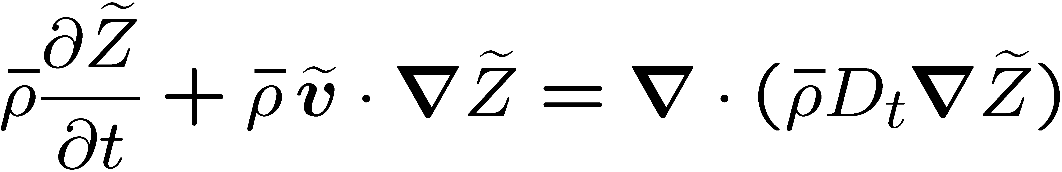
Models in nonpremixed turbulent combustion are often based on the presumed
shape pdf approach.
This requires the knowledge of the Favre mean mixture fraction and its variance at position x and time t.
A of the mixture fraction equation and using the gradient transport assumption led to the equation for the Favre mean mixture fraction
Molecular diffusion is much smaller than the turbulent diffusion, and has therefore been neglected.
14.-2

Slide 3
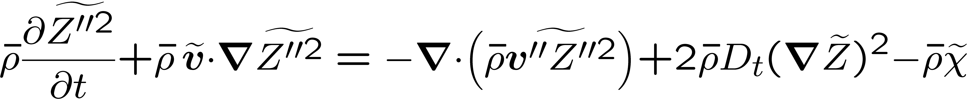
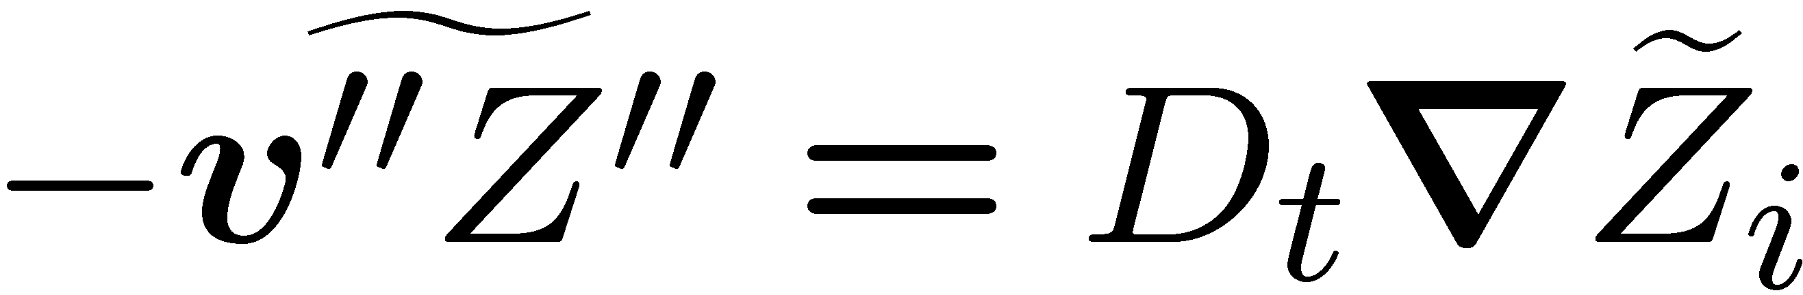
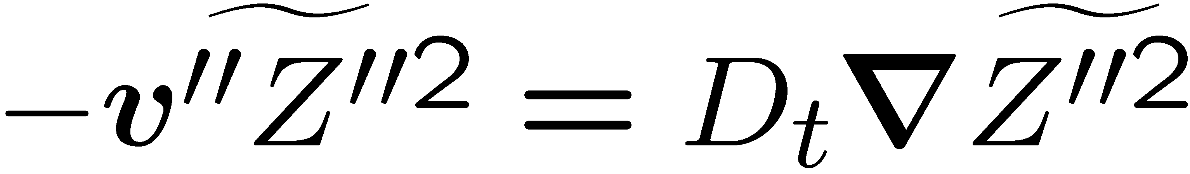
In addition to the mean mixture fraction we have derived an equation for the Favre variance of the mixture fraction
where the gradient transport assumption
has again been used in the production term, second term of the r.h.s.
For the turbulent flux of the mixture fraction variance the gradient transport assumption
can also be used.
14.-3

Slide 4
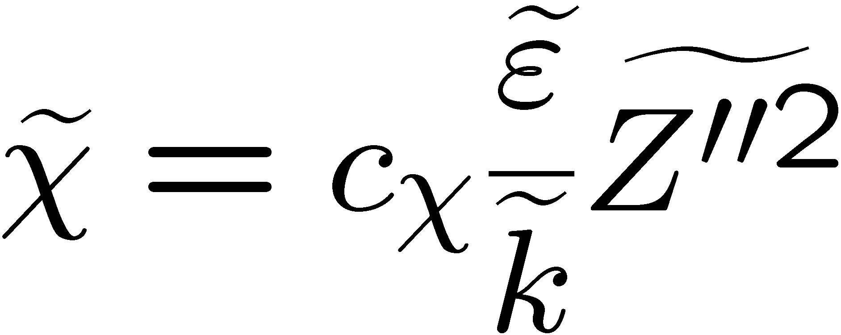
In
the mean scalar dissipation rate appears, which as introduced in Lecture 10 will be modeled as
where the time scale ratio c_{χ} is assumed to be a constant.
14.-4

Slide 5
In the model
Janicka and Peters (1982) found that a value of c_{χ}=2.0 would predict the decay of scalar variance in an inert jet of methane very well.
Overholt and Pope (1996) and Juneja and Pope (1996) performing DNS studies
of one and two passive scalar mixing find an increase of c_{χ} with Reynolds number and steady state values around 2.0 and 3.0, respectively.
In the numerical simulations of Diesel engine combustion, to be presented in Lecture 15, a value of c_{χ}=2.0 has been used.
14.-5

Slide 6
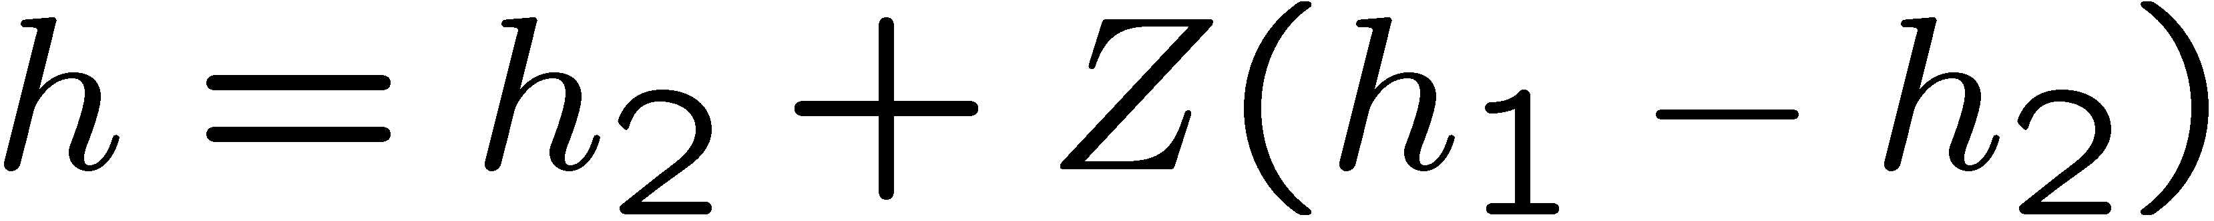
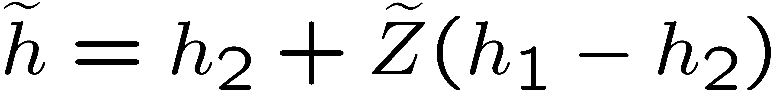
In many cases, as in turbulent jet diffusion flames in air, zero gradient
boundary conditions, except at the inlet, can be imposed.
If the simplifying assumptions mentioned in Section 3.9 of Lecture 3 can be introduced the enthalpy h can be related to the mixture fraction by the linear coupling relation
which also holds for the mean values
and no additional equation for the enthalpy is required.
14.-6

Slide 7
In and
h₂ is the enthalpy of the air and h₁ that of the fuel.
A more general formulation is needed, if different boundary conditions have to be applied for the Favre mean mixture fraction and enthalpy or if heat loss due to radiation or unsteady pressure changes must be accounted for.
Then an equation for the Favre mean enthalpy as an additional variable must be solved.
14.-7

Slide 8
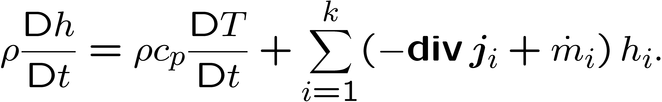
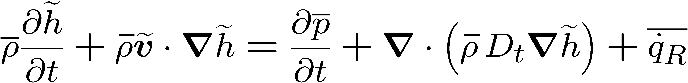
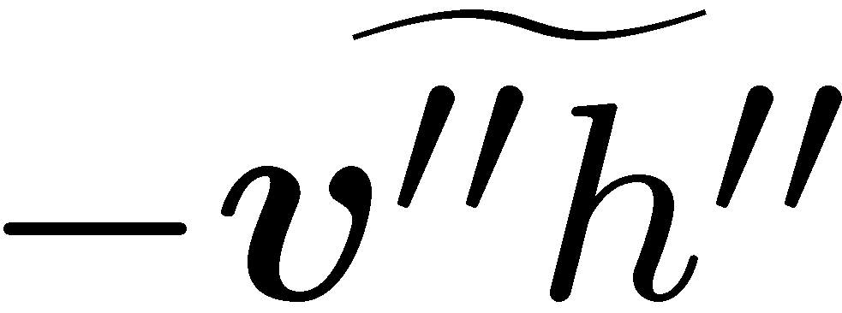
This equation can be obtained from the enthalpy equation
by averaging
again a gradient transport equation for the correlation has been introduced.
14.-8

Slide 9
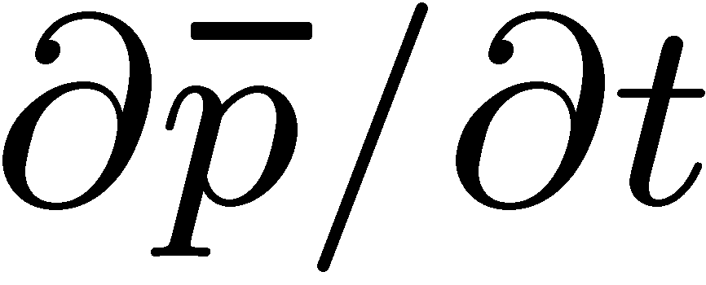
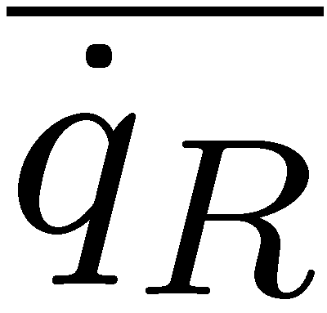
The term describing temporal mean pressure changes has been retained, because it is important for the modeling of combustion in internal combustion engines operating under nonpremixed conditions, such as the Diesel engine.
The mean volumetric heat exchange term must also be retained in many applications where radiative heat exchange has an influence on the local enthalpy
balance.
Changes of the mean enthalpy also occur due to convective heat transfer at the boundaries or due to the evaporation of a liquid fuel.
Temperature changes due to radiation within the flamelet structure also have a strong influence on the prediction of NO_{x} formation (cf. Pitsch et al. ,1998).
14.-9

Slide 10
Presumed Shape Pdf Approach
The modelling eqations can be used to calculate the mean mixture fraction and the mixture fraction variance at each point of the turbulent flow field, provided that the density field is known.
In addition, of course, equations for the turbulent flow field, the Reynolds stress equations (or the equation for the turbulent kinetic energy) and the equation for the dissipation must be solved.
14.-10

Slide 11
In this approach a suitable two-parameter probability density function is "presumed" in advance, thereby fixing the functional form of the pdf by relating the two parameters in terms of the known values of the mean mixture fraction and its variance at each point of the flow field.
Since in a two-feed system the mixture fraction Z varies between Z = 0 and
Z = 1, the beta function pdf is widely used for the Favre pdf in nonpremixed turbulent combustion.
14.-11

Slide 12
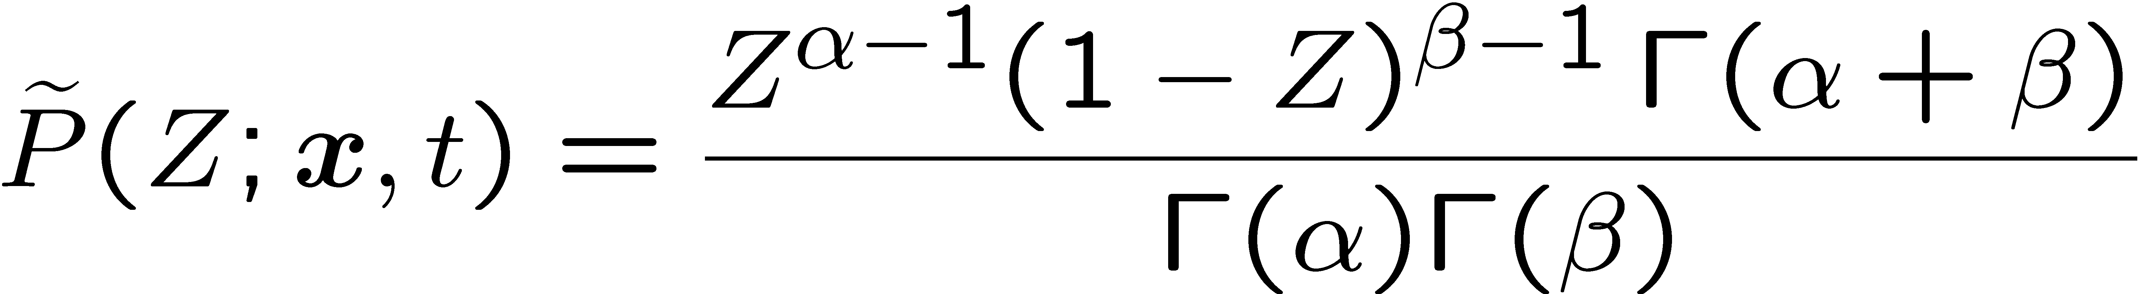
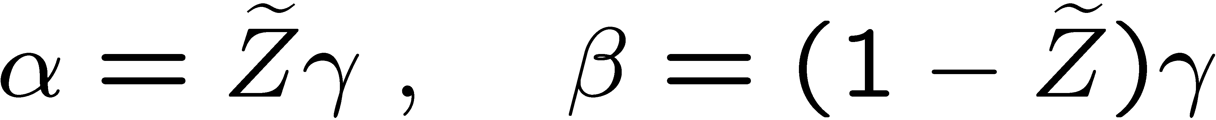
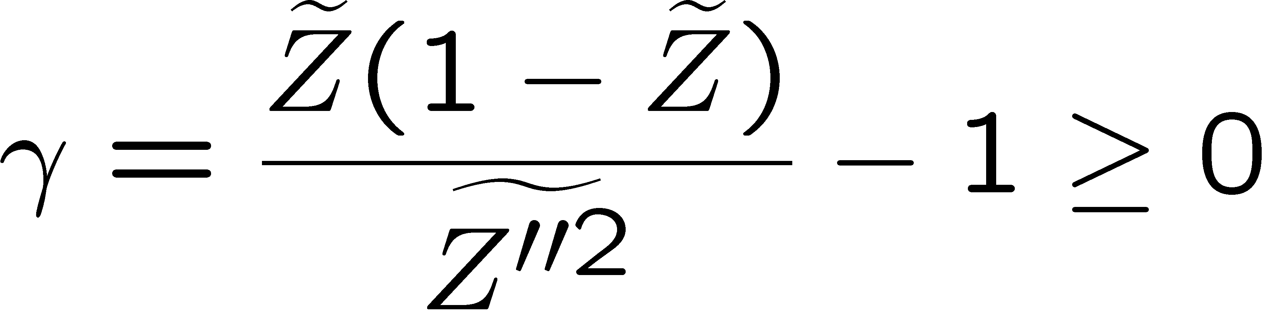
The beta-function pdf has the form
Here Γ is the gamma function.
The two parameters α and β are related to the Favre mean mixture fraction and its variance by
where
14.-12

Slide 13
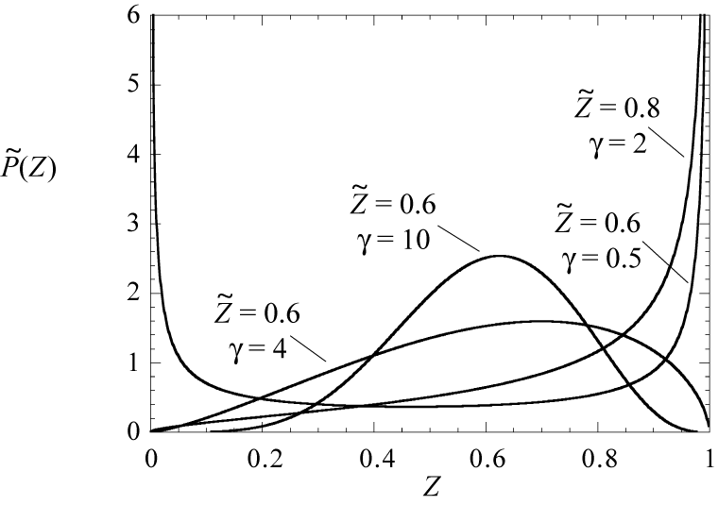
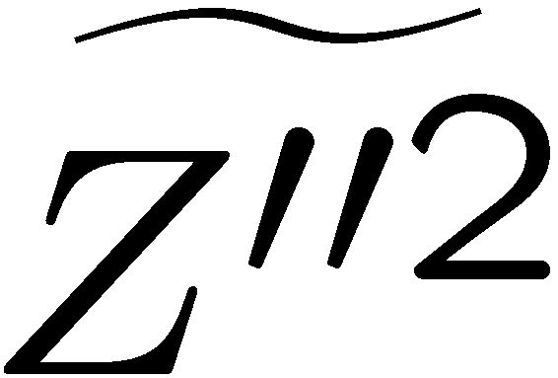
The beta-function plotted for different combinations of its parameters
It can be shown that in the limit of very small (large γ) it approaches a Gaussian distribution.
14.-13

Slide 14
For α <1 it develops a singularity at Z = 0 and for β < 1 a singularity at Z = 1.
Despite of its surprising flexibility, it is unable to describe distributions with
a singularity at Z = 0 or Z = 1 and an additional intermediate maximum in the range 0 < Z < 1.
14.-14

Slide 15
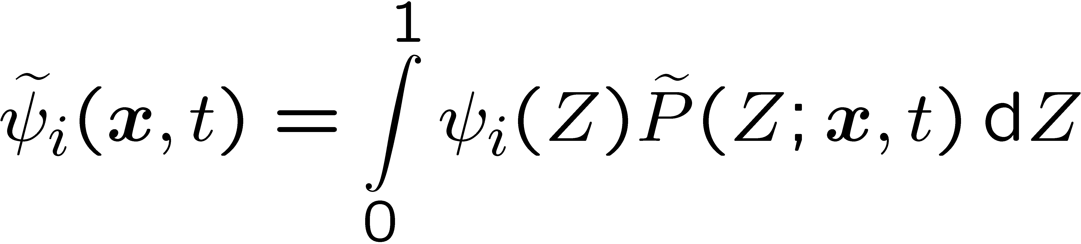
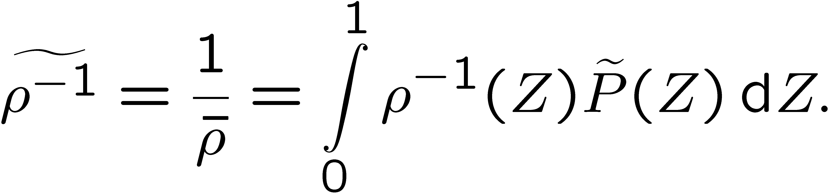
By the presumed shape pdf approach means of any quantity that depends only on the mixture fraction can be calculated.
For instance, the mean value of ψ_{i} can be obtained from
A further quantity of interest is the mean density.
Since Favre averages are considered, one must take the Favre average of ρ⁻¹, which leads to
14.-15

Slide 16
With
and the Burke-Schumann solution the Conserved´Scalar Equilibrium Model for nonpremixed combustion is formulated.
It is based on a closed set of equations which do not require any further chemical input other than the assumption of infinitely fast chemistry.
It may therefore be used as an initial guess in a calculation where the Burke-Schumann solution or the equilibrium solution later on is replaced by the solution of the flamelet equations to account for non-equilibrium effects.
14.-16

Slide 17
The Round Turbulent Jet Diffusion Flame
In many applications fuel enters into the combustion chamber as a turbulent jet,
with or without swirl.
To provide an understanding of the basic properties of jet diffusion flames, we will consider here the easiest case, the axisymmetric jet flame without buoyancy, for which we can obtain approximate analytical solutions.
This will enable us to determine, for instance, the flame length.
The flame length is defined as the distance from the nozzle to the point on the centerline of the flame where the mean mixture fraction is equal to Z_{st}.
14.-17

Slide 18
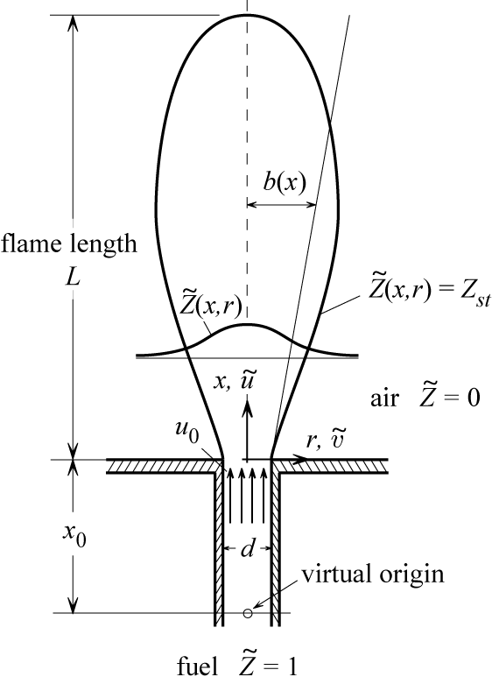
The flow configuration for the round turbulent jet flame
14.-18

Slide 19
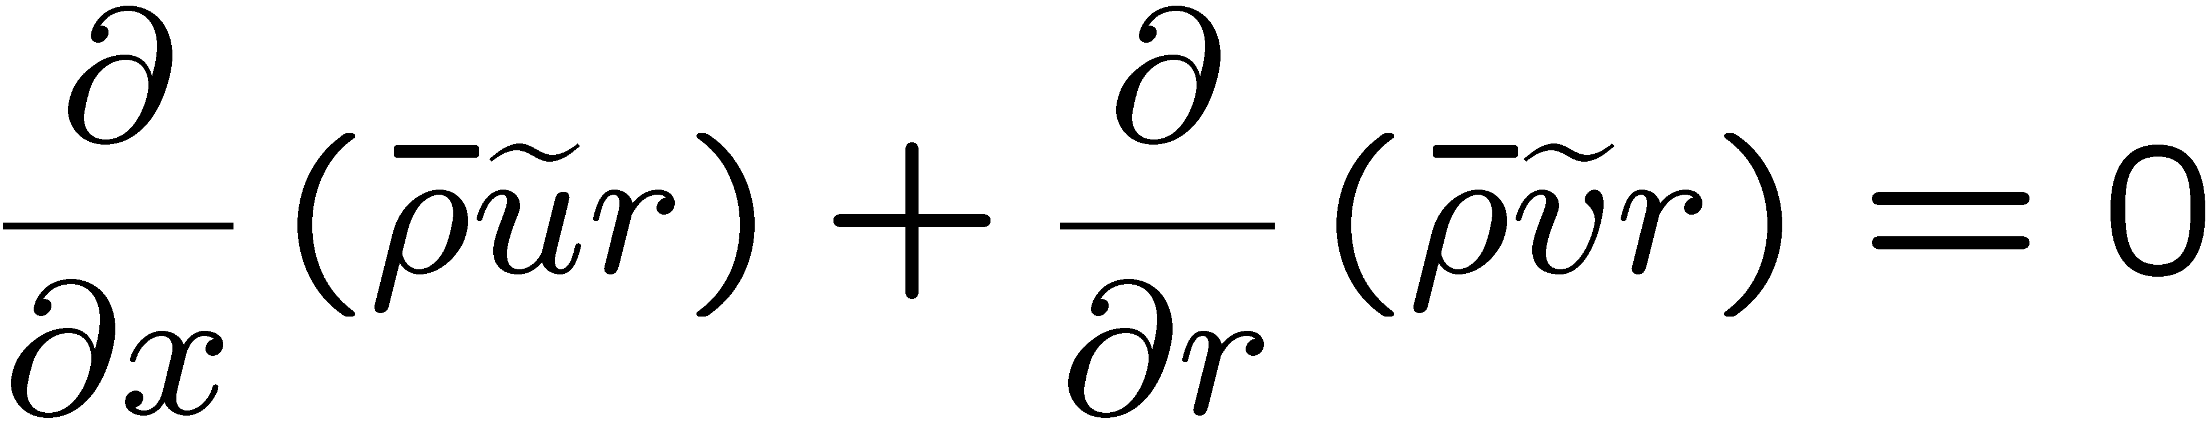
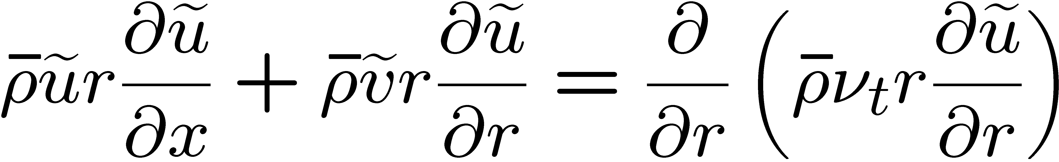
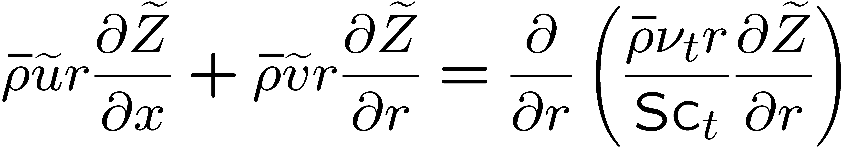
Using Favre averaging and the the boundary layer assumption we obtain a system of two-dimensional axisymmetric equations
continuity
momentum in x-direction
mean mixture fraction
14.-19

Slide 20
We have neglected molecular as compared to turbulent transport terms.
Turbulent transport was modeled by the gradient flux approximation.
For the scalar flux we have replaced D_{t} by introducing the turbulent Schmidt number Sc_{t}=ν_{t}/D_{t}.
For simplicity, we will not consider equations for the turbulent kinetic energy and its dissipation or the mixture fraction variance but seek an approximate solution by
introducing a model for the turbulent viscosity ν_{t}.
Details may be found in Peters and Donnerhack (1981).
14.-20

Slide 21
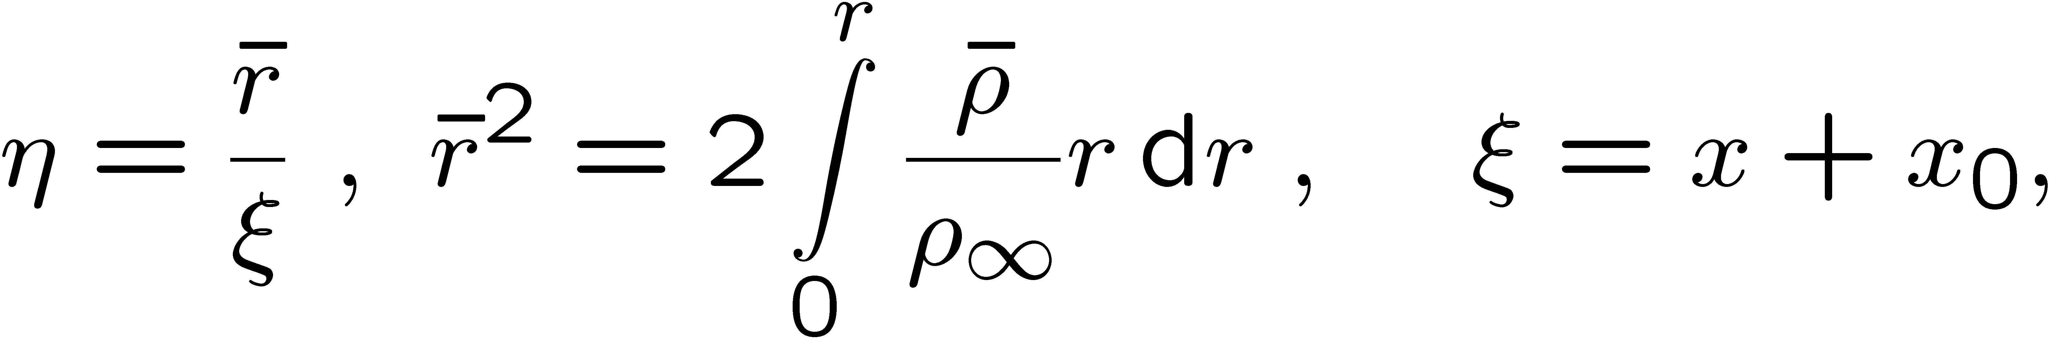
As for the laminar solution of Lecture 9
for the round diffusion flame the
dimensionality of the problem will again
be reduced by introducing the
similarity transformation
which contains a density transformation defining the density weighted radial
co-ordinate.
The new axial co-ordinate ξ starts from the virtual origin of the jet
located at x = - x₀.
14.-21

Slide 22
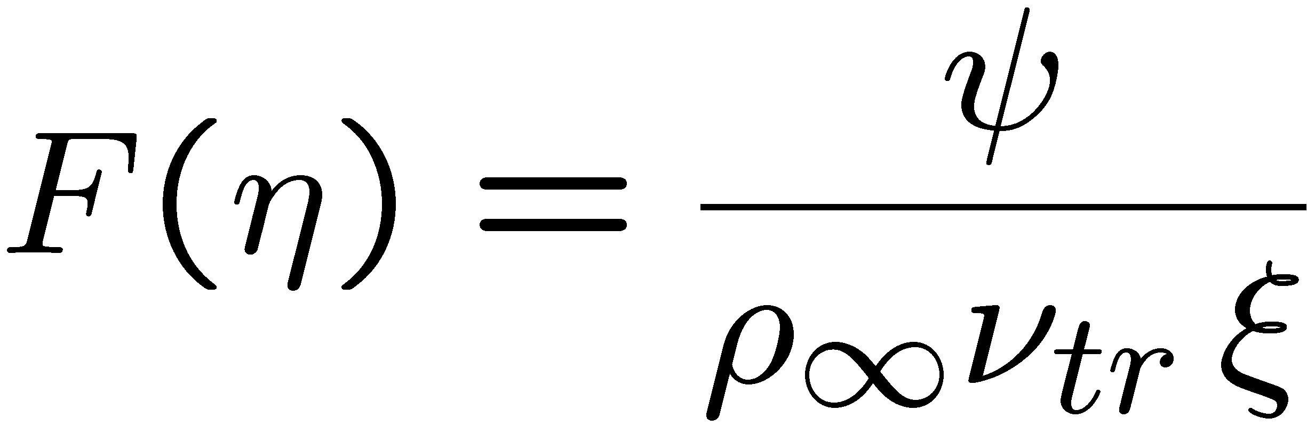
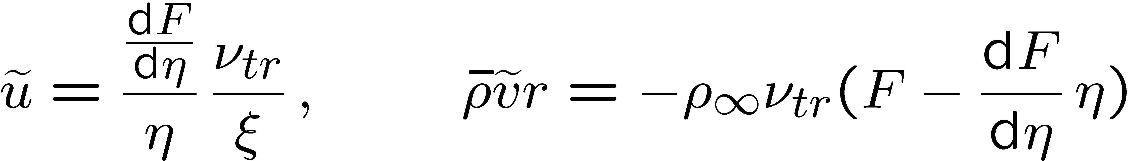
Introducing a stream function ψ by
the continuity equation
is satisfied.
In terms of the non-dimensional stream function F(η) defined by
the axial and radial velocity components may now be expressed as
14.-22

Slide 23
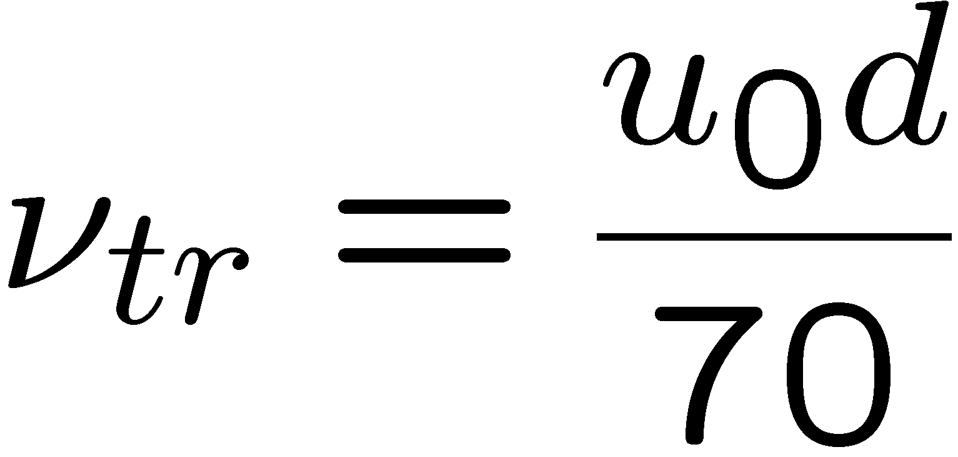
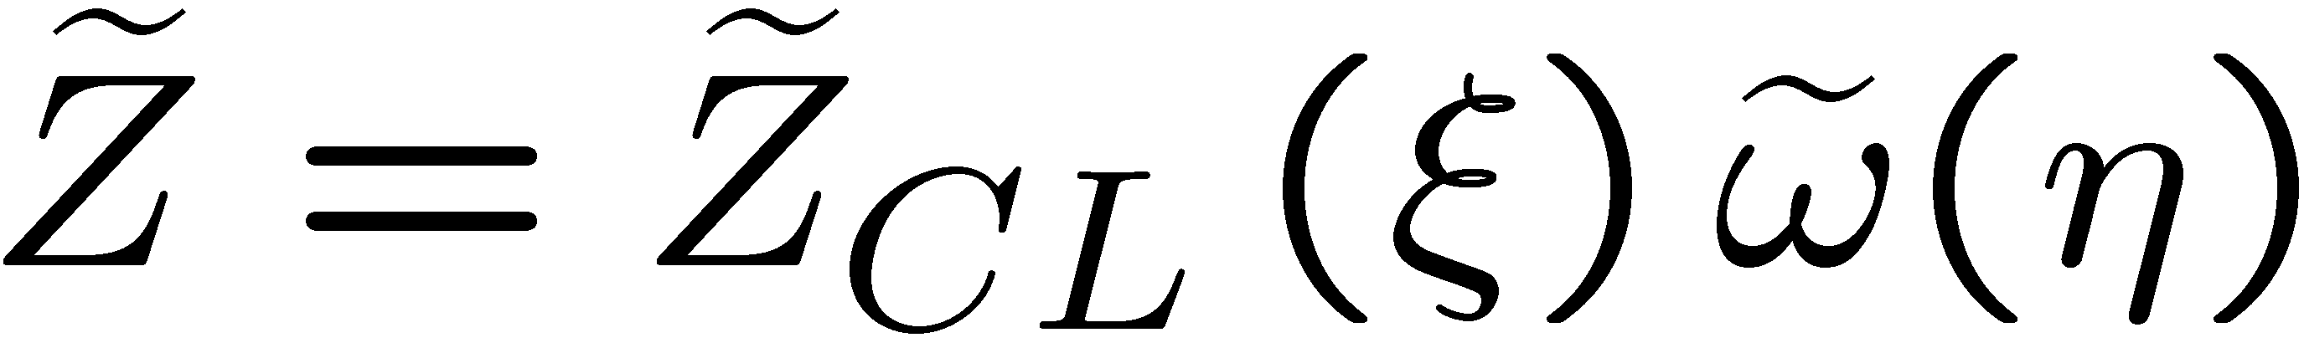
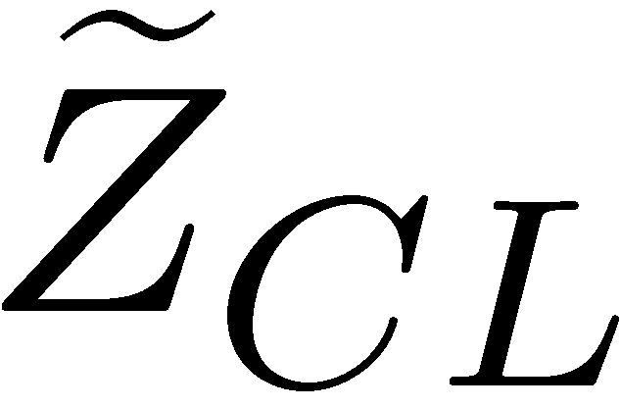
Here ν_{tr} is the eddy viscosity of a constant density jet, used as a reference value.
Differently from the laminar flame, where ν is a molecular property,
ν_{tr} has been fitted (cf. Peters and Donnerhack (1981) to experimental data as
For the mixture fraction the ansatz
is introduced, where stands for the Favre mean mixture fraction on the centerline.
14.-23

Slide 24
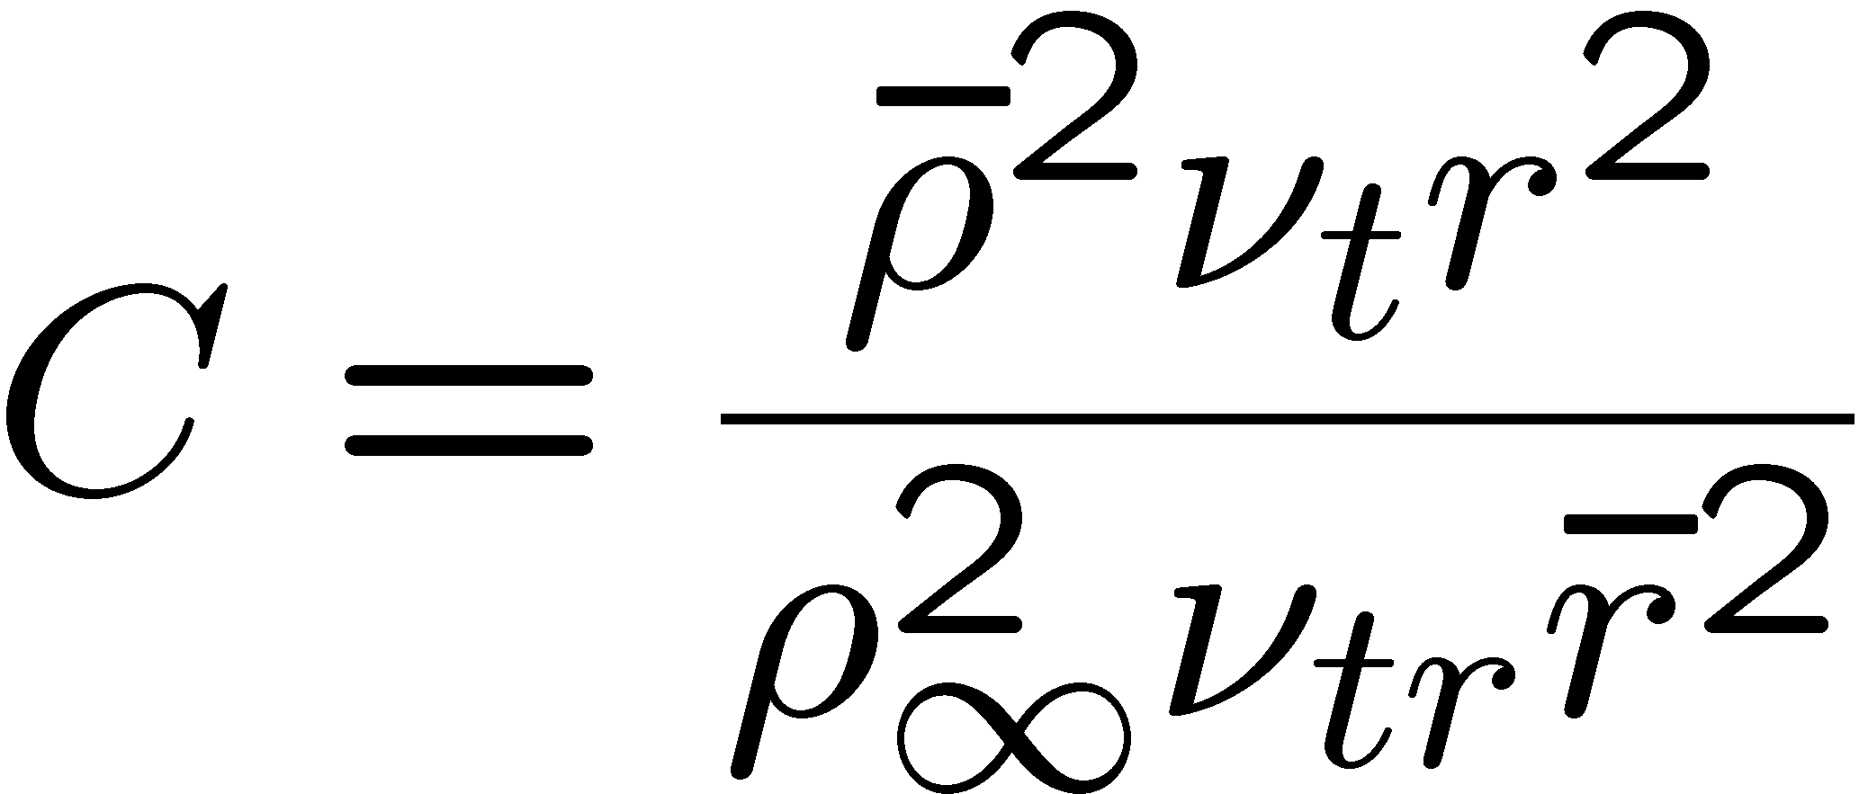
The system of equation for the turbulent round jet has the same similarity solution as the one derived in Section 9.2 of Lecture 9.
Here we approximate the Chapman-Rubesin parameter, however, as:
In order to derive an analytical solution it must be assumed that C is a constant in the entire jet.
14.-24

Slide 25
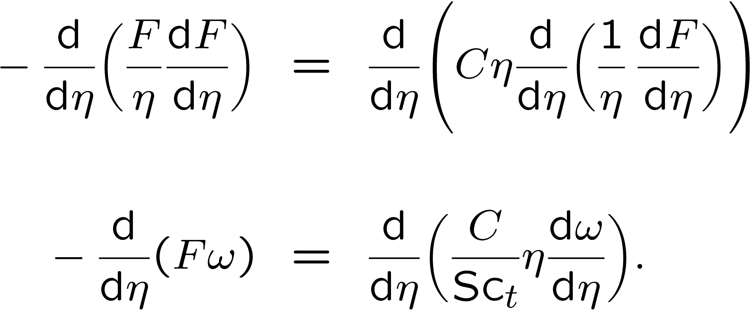
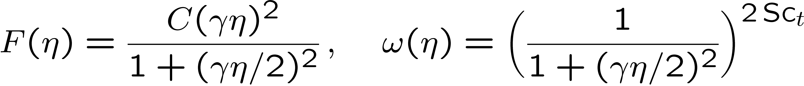
With a constant value of C and if the Schmidt number is replaced by a turbulent Schmidt number Sc_{t} one obtains the system of differential equations
and its solution
14.-255

Slide 26
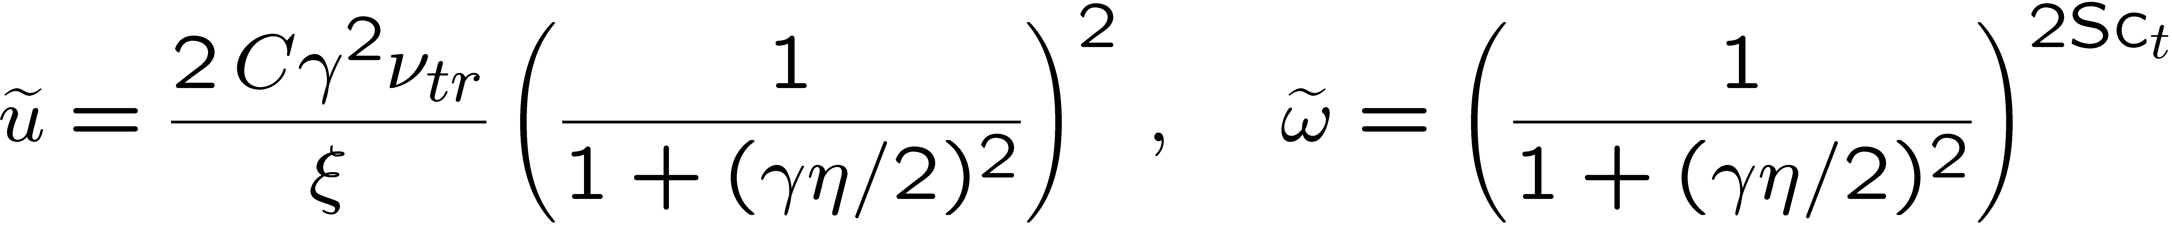
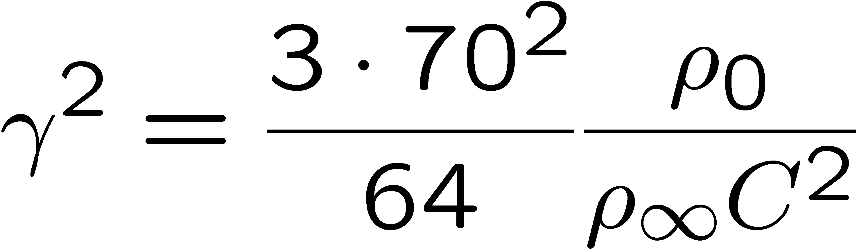
The solution reads
where the jet spreading parameter is now
obtained from the requirement of integral momentum conservation along the axial
direction.
14.-26

Slide 27
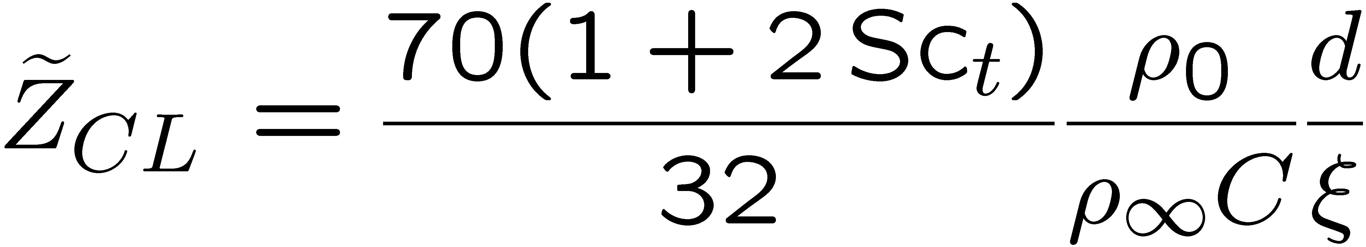
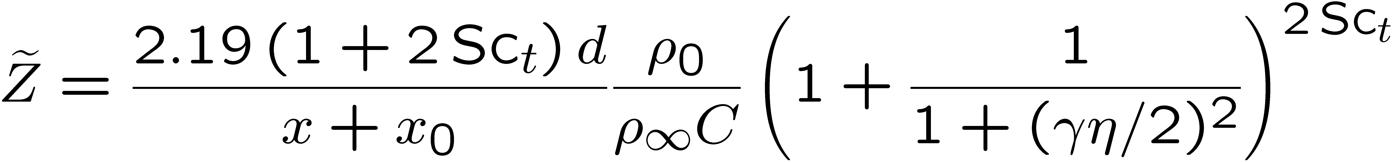
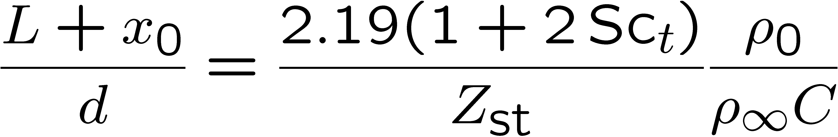
Similarly, conservation of the mixture fraction integral across the jet yields the mixture fraction on the centerline
such that the mixture fraction profile is given by
From this equation the flame length L can be calculated by setting
We get
14.-27

Slide 28
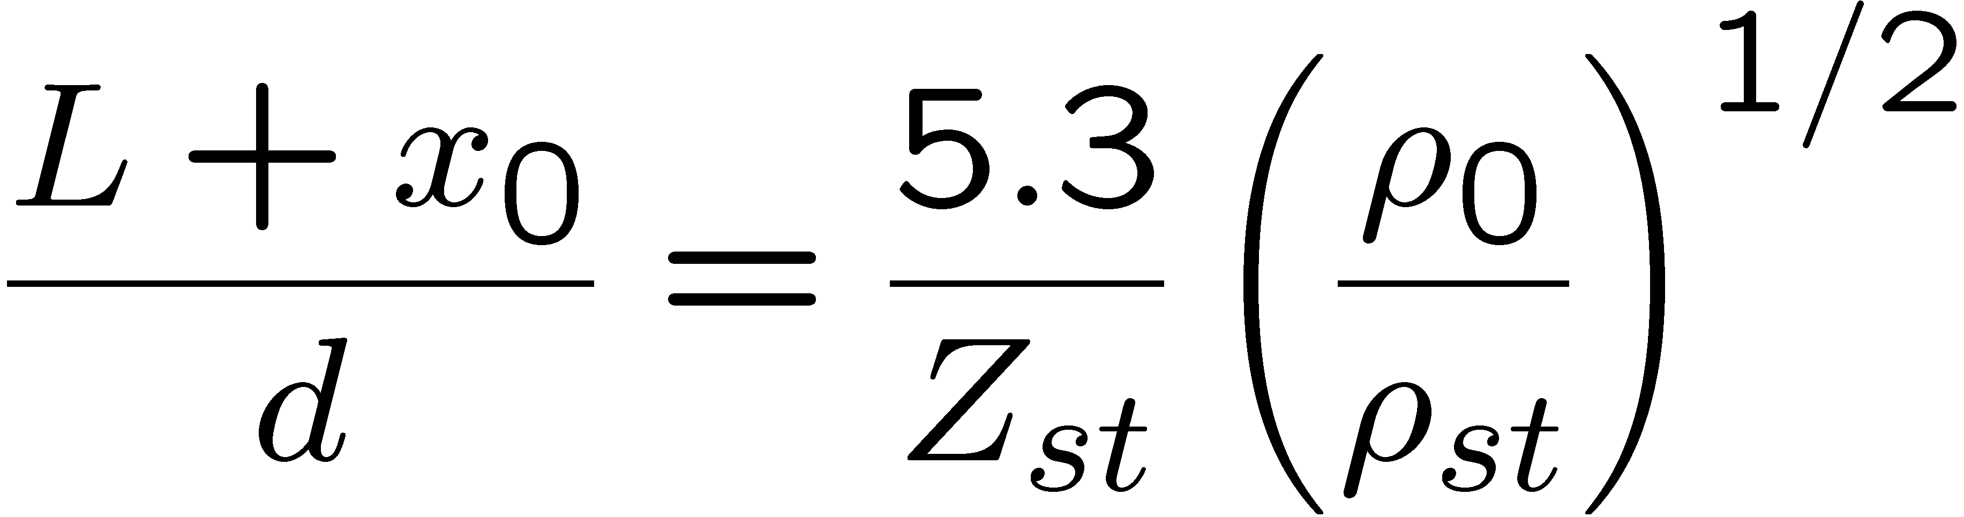
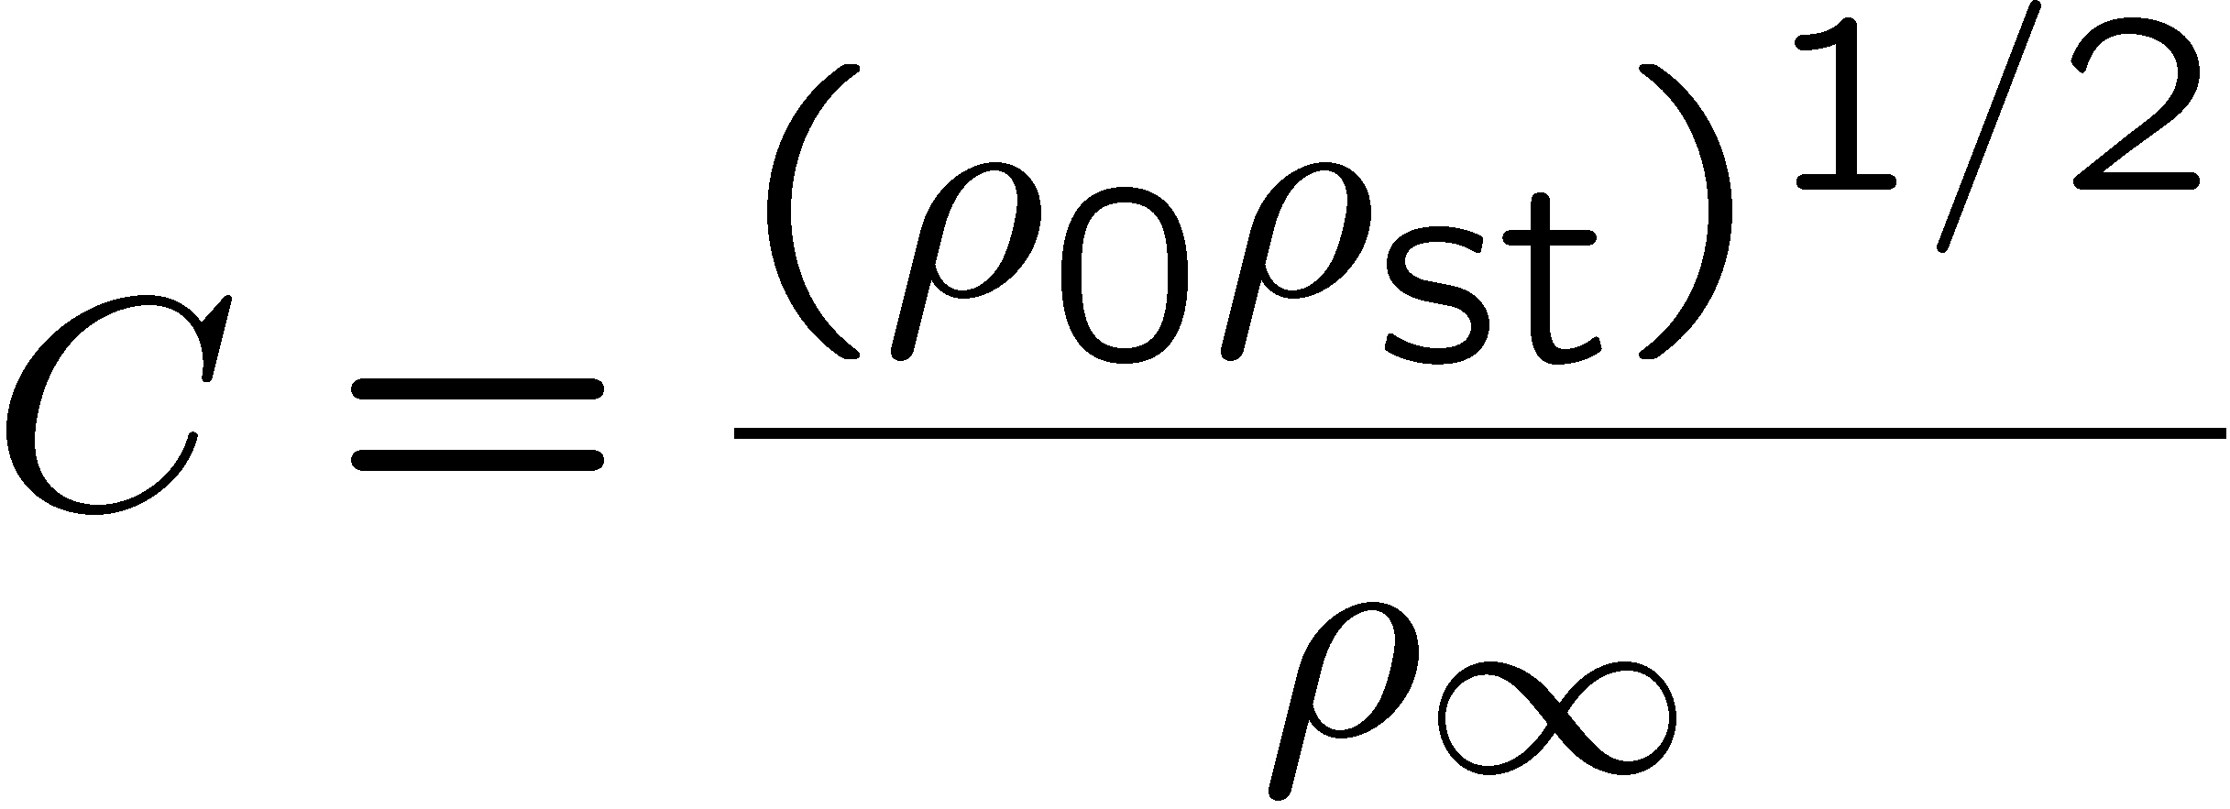
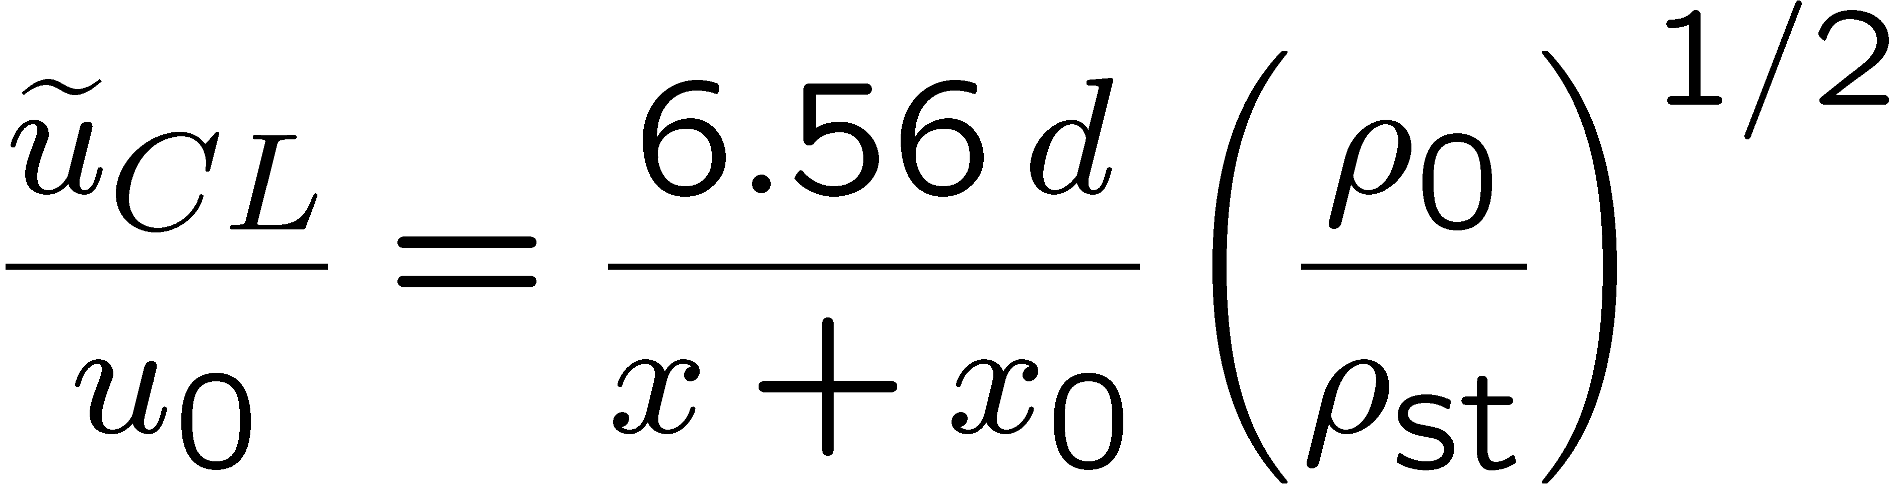
Experimental data by Hawthorne et al. (1949) suggest that the flame length L should scale as
This fixes the turbulent Schmidt number as Sc_{t}=0.71 and the Chapman-Rubesin
parameter as
When this is introduced into the solution, one obtains the centerline velocity as
14.-28

Slide 29
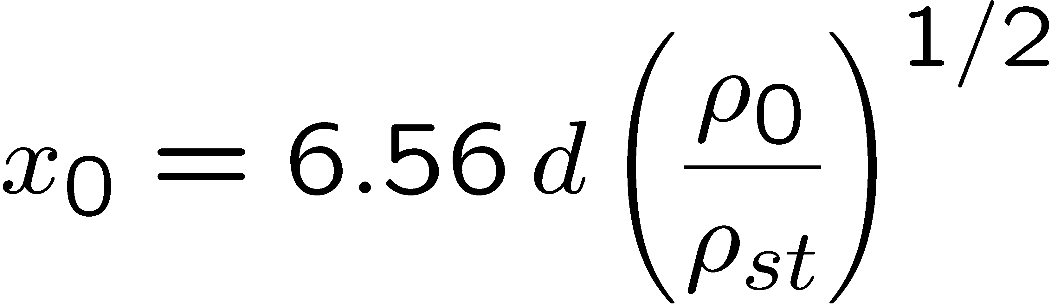
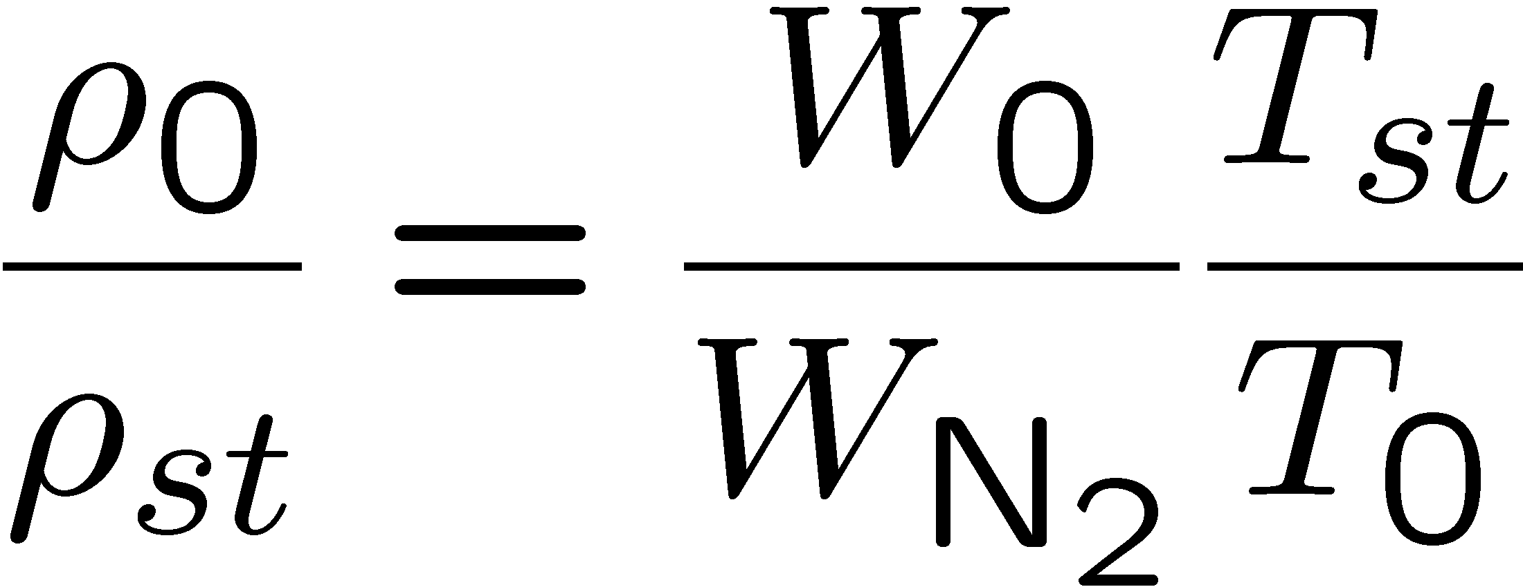
The distance of the virtual origin from x = 0 may be estimated
by setting
in
so that
As an example for the flame length, we set the molecular weight at stoichiometric mixture equal to that of nitrogen, thereby estimating the density ratio ρ₀ / ρ_{st} from
14.-29

Slide 30
The flame length may then be calculated from
with Z_{st} = 0.055 as L ~ 200 d
In large turbulent diffusion flames buoyancy influences the turbulent
flow field and thereby the flame length.
In order to derive a scaling law for that case, Peters and Göttgens (1991) have integrated the boundary layer equations for momentum and mixture fraction for
a vertical jet flame over the radial direction in order to obtain first order
differential equations in terms of the axial co-ordinate for cross-sectional averages of the axial velocity and the mixture fraction.
14.-30

Slide 31
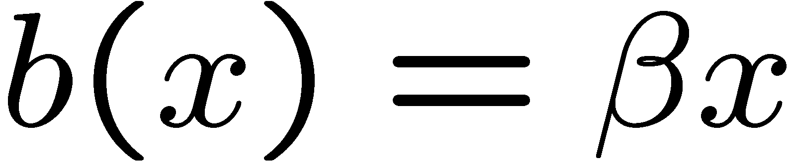
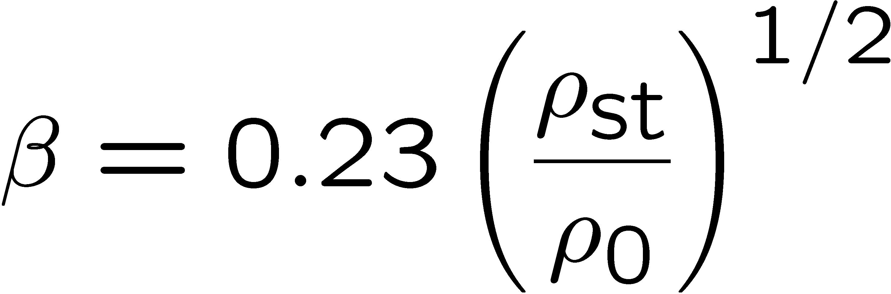
Since turbulent transport disappears entirely due to averaging, an empirical model for the entrainment coefficient β is needed, which relates the half-width b of the jet to the axial co-ordinate as
By comparison with the similarity solution for a non-buoyant jet β was determined as
Details of the derivation may be found in Peters and Göttgens (1991).
14.-31

Slide 32
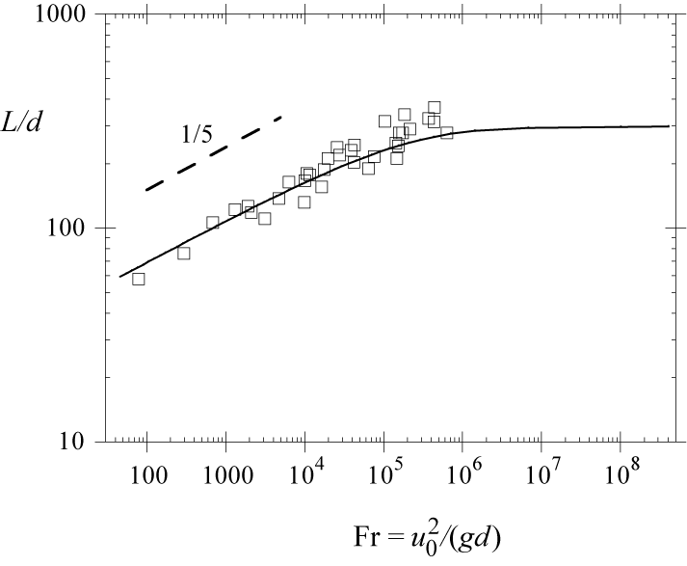
The predicted flame length of propane flames is compared with measurements
from Sønju and Hustad (1984).
For Froude numbers
smaller than 10⁵ the data show
a Froude number scaling as
Fr^{1/5}, which corresponds to a
balance of the second term on the
l.h.s. with the term on the r.h.s.
14.-32

Slide 33
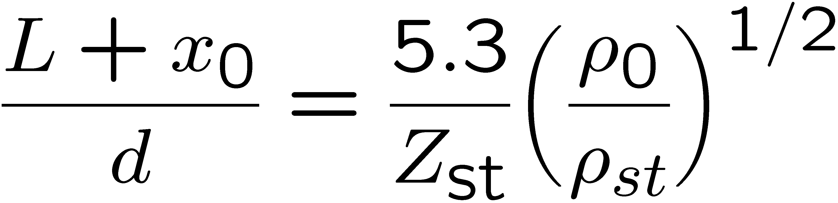
For Froude numbers larger than 10⁶ the flame length becomes Froude number independent equal to the value calculated from
14.-33

